Slide 1
Topic: Fractions
EQ: How do I find fractions of a group?
INB and assessment

Slide 2
There are 12 children in Debbie’s class who are getting stickers ( one for each child) from their teacher. Read through the information and work out how many kids received each sticker.
INFORMATION:
Half of them chooses the blue smile sticker
One quarter of them choose the yellow smile sticker
The rest choose the pink star sticker
Use the paper circles to work out how many of each colour there are
Get teacher to check paper circles
Draw the stickers in your interactive notebook and answer the rest of the questions

Slide 3
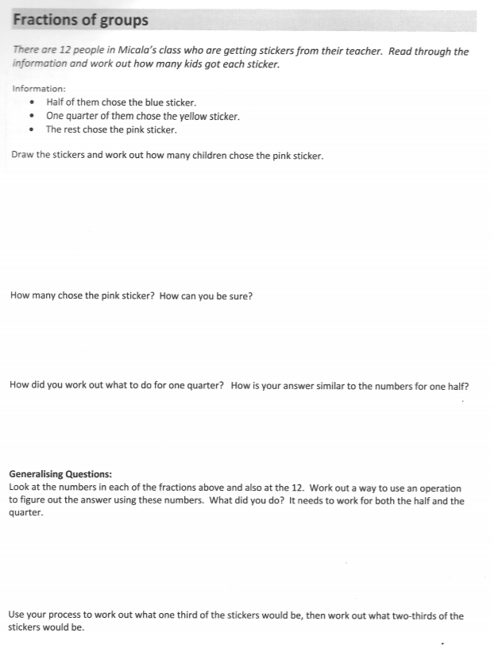

Slide 4
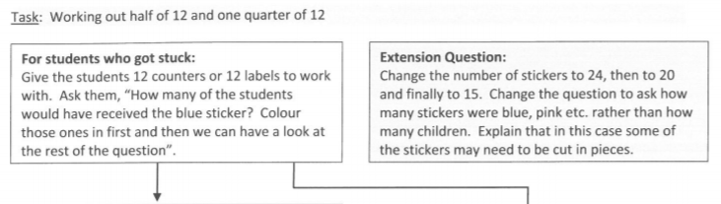
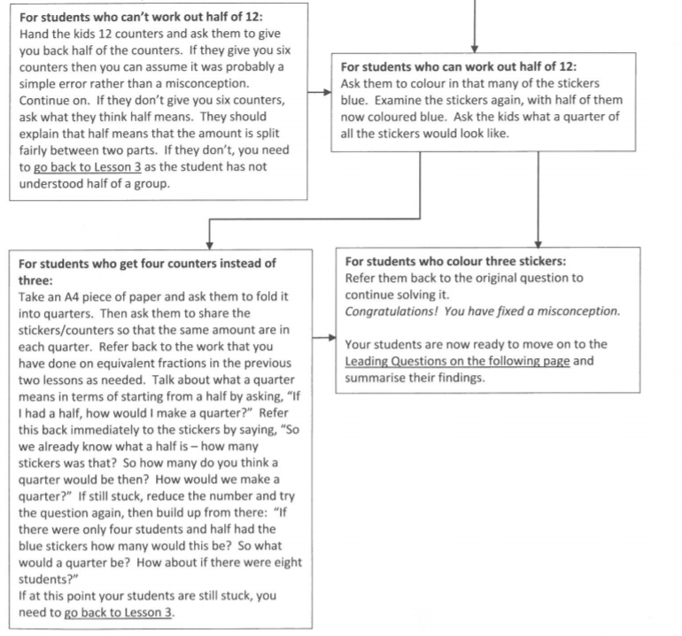

Slide 5
